Slide 1
Malignant Comment Classification
Preeti Singh

Slide 2


Agenda
A
Acknowledgement
Introduction
Analytical Problem Framing
Model/s Development and Evaluation
Conclusion

Slide 3
Acknowledgement
I would like to thank Flip Robo Technologies for providing me with the opportunity to work on this project from which I have learned a lot. I am also grateful to Ms. Gulshana Chaudhary for her constant guidance and support. Reference sources are: -
Google
Stackoverflow.com
Analytics vidhya
Notes and repository from DataTrained
Research papers – https://www.nltk.org/book/ch05.html
https://www.analyticsvidhya.com/blog/2017/01/ultimate-guide-tounderstand-implement-natural-language-processing-codes-in-python/

Slide 4
Introduction
• Business Problem Framing
The proliferation of social media enables people to express their opinions widely online. However, at the same time, this has resulted in the emergence of conflict and hate, making online environments uninviting for users. Although researchers have found that hate is a problem across multiple platforms, there is a lack of models for online hate detection.
Online hate, described as abusive language, aggression, cyberbullying, hatefulness and many others has been identified as a major threat on online social media platforms. Social media platforms are the most prominent grounds for such toxic behaviour.
There has been a remarkable increase in the cases of cyberbullying and trolls on various social media platforms. Many celebrities and influences are facing backlashes from people and have to come across hateful and offensive comments. This can take a toll on anyone and affect them mentally leading to depression, mental illness, self-hatred and suicidal thoughts.

Slide 5
• Conceptual Background of the Domain Problem
Internet comments are bastions of hatred and vitriol. While online anonymity has provided a new outlet for aggression and hate speech, machine learning can be used to fight it. The problem we sought to solve was the tagging of internet comments that are aggressive towards other users. This means that insults to third parties such as celebrities will be tagged as unoffensive, but “u are an idiot” is clearly offensive.
Our goal is to build a prototype of online hate and abuse comment classifier which can used to classify hate and offensive comments so that it can be controlled and restricted from spreading hatred and cyberbullying.

Slide 6
Analytical Problem Framing

Slide 7
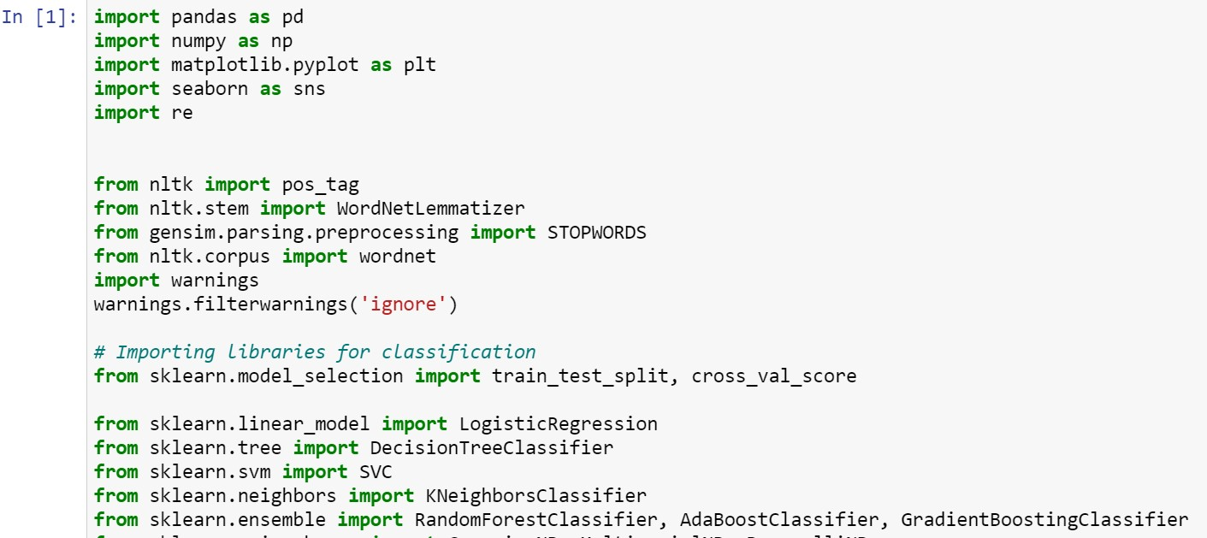
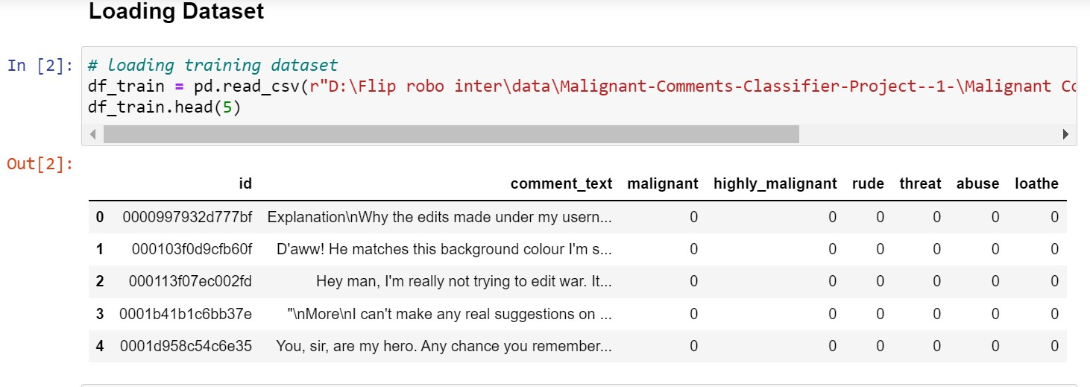
Data Pre-processing
Data pre-processing is the data mining technique that involves transforming raw data into an understandable data format. So, in data pre-processing technique first step is import data and the libraries to be used in model building.

Slide 8
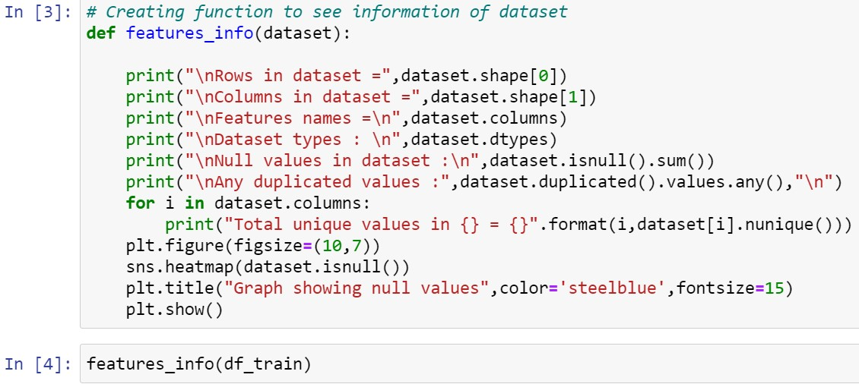
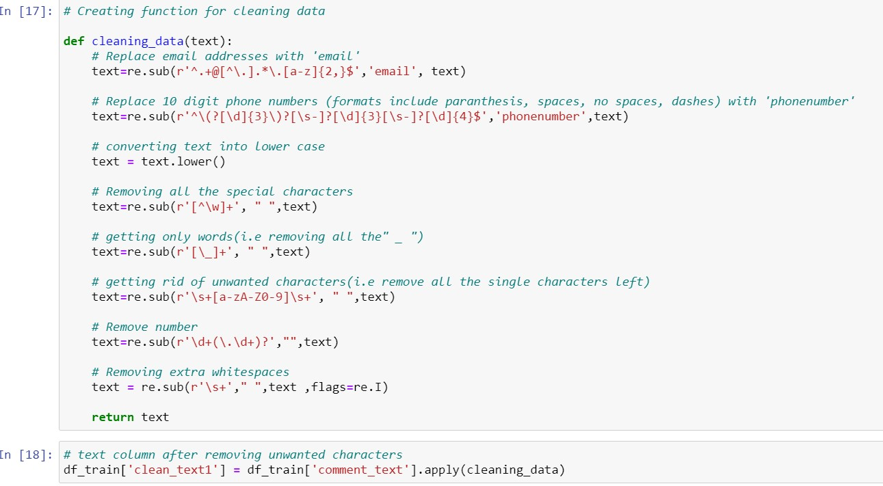
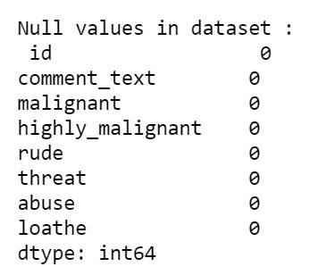
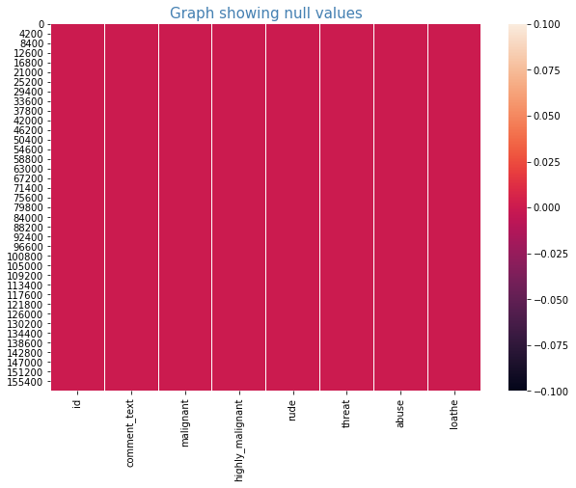
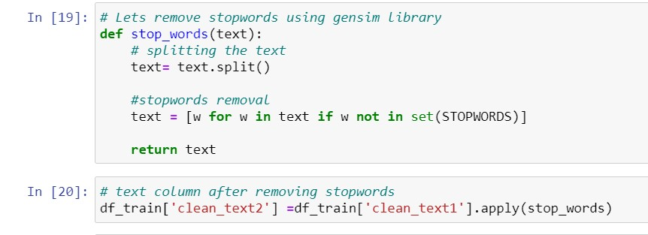
Null Values
Data Cleaning

Slide 9
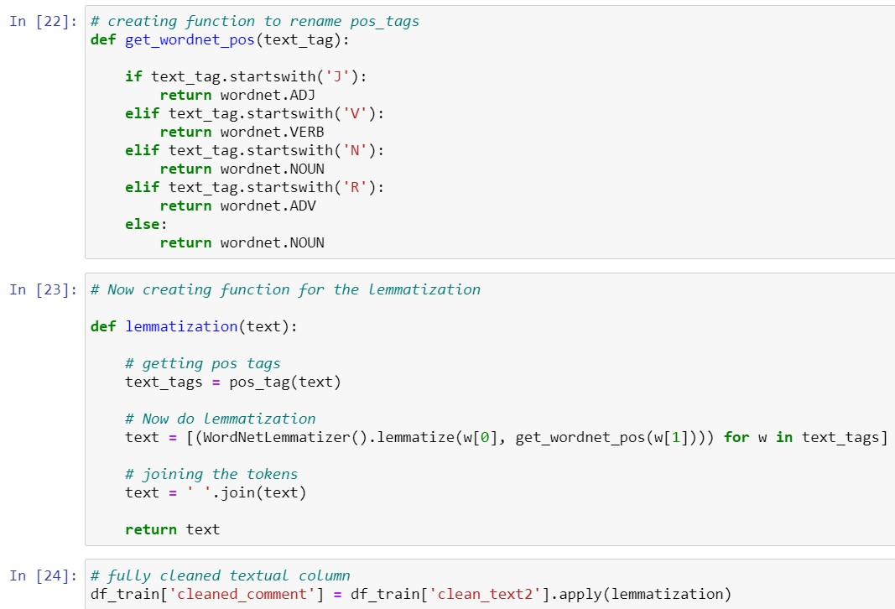
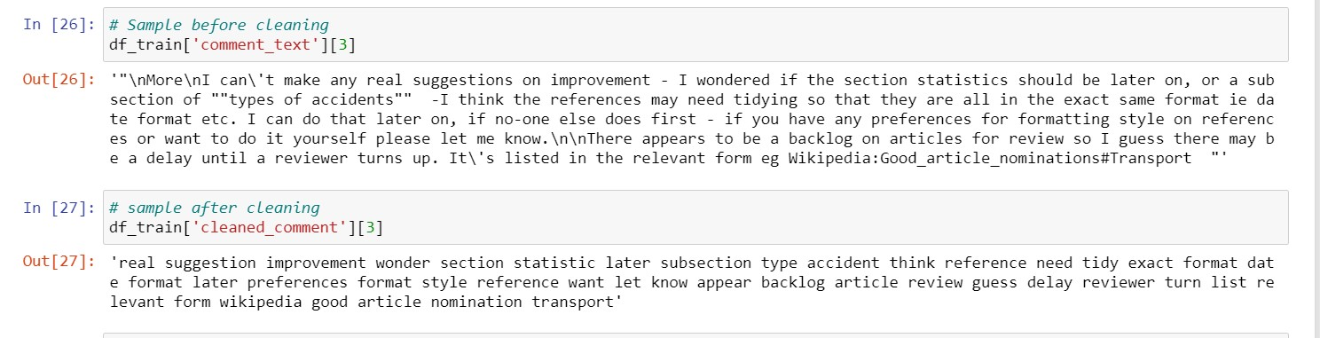
After removing all the unnecessary words or numbers we converted the words into their simpler form using the Lemmatization process. In this process we defined two functions, first one will tag the words into proper format and the other function will convert them into simpler form using the tagged alphabet.
Encoding the categorical data (Feature Extraction and scaling)
As of now we had cleaned the data, now another major step towards building a model is to convert the textual data into numerical form because our algorithms understand only the numerical data. So, for converting into numerical or vector form we used Tf-Idf Vectorizer technique which converted the textual data into the vectors using the terms frequency method.

Slide 10
Model/s Development and Evaluation.
“
”

Slide 11
Identification of possible problem-solving approaches (methods)
In this project there were 5-6 features which defines the type of comment like malignant, hate, abuse, threat, loathe but we created another feature named as “negative_cmnts” which is combined of all the above features and contains the labelled data into the format of 0 and 1 where 0 represents “NO” and 1 represents “Yes”.
As we have labelled data into our target feature which is the case of classification method. So, we are going to use algorithms based on classification
Testing of Identified Approaches (Algorithms)
Based on the classification approach we are going to use following approaches:
Logistic Regression
Decision Tree Classifier
RandomForest Classifier
AdaBoost Classifier
GradientBoosting Classifier
In NLP we use Naïve Bayes algorithms mostly but due to our systems we faced memory error to deal with them.

Slide 12
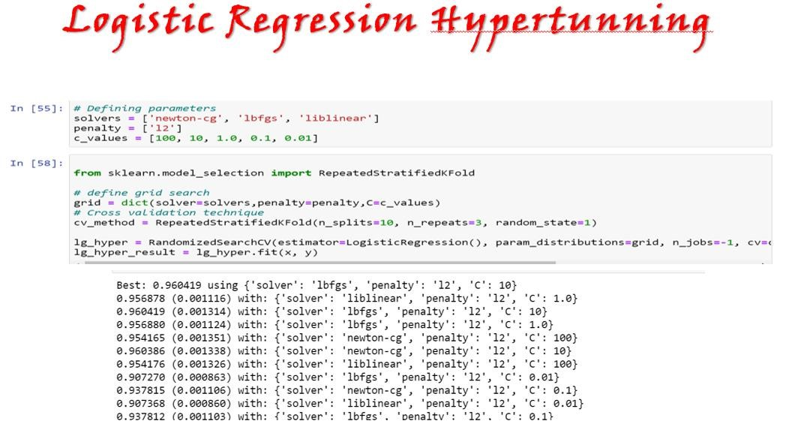
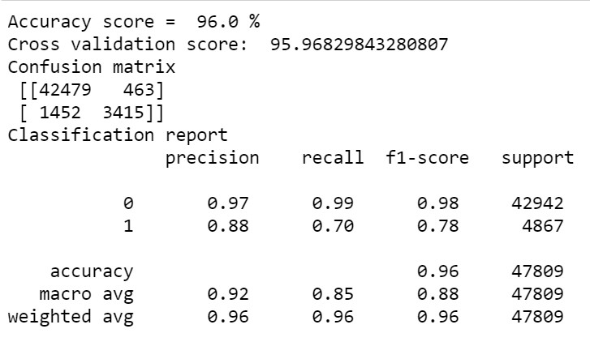
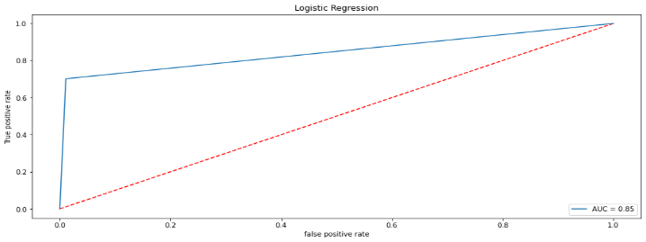

Slide 13
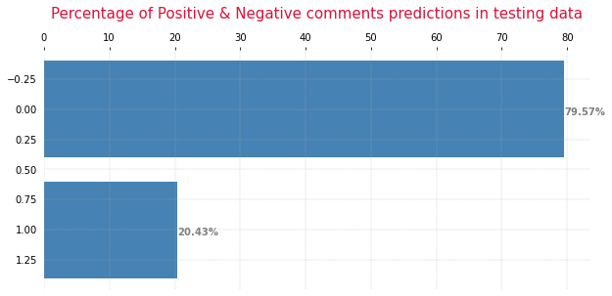
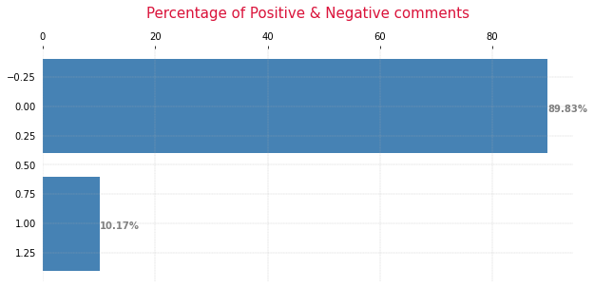

Slide 14
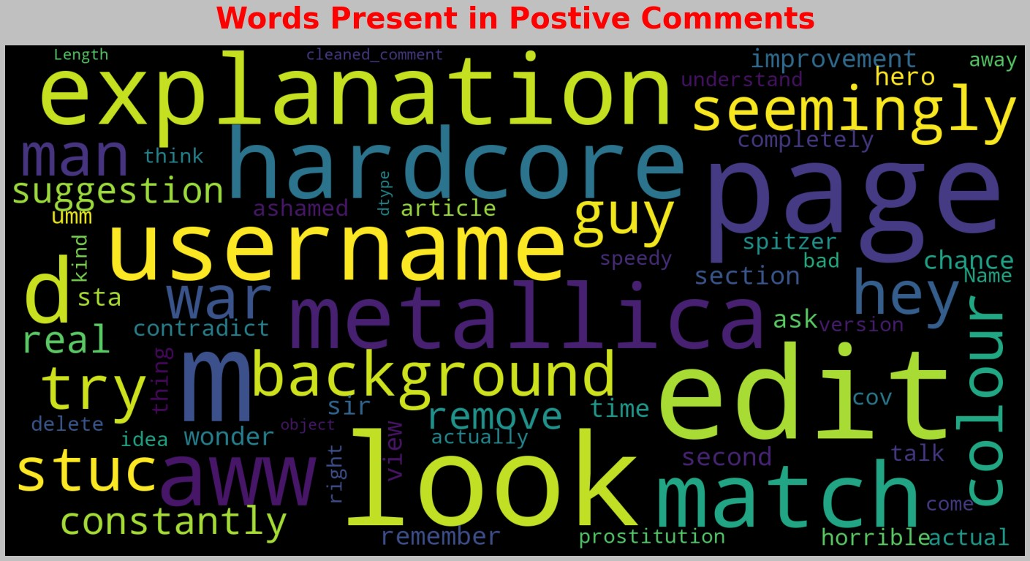
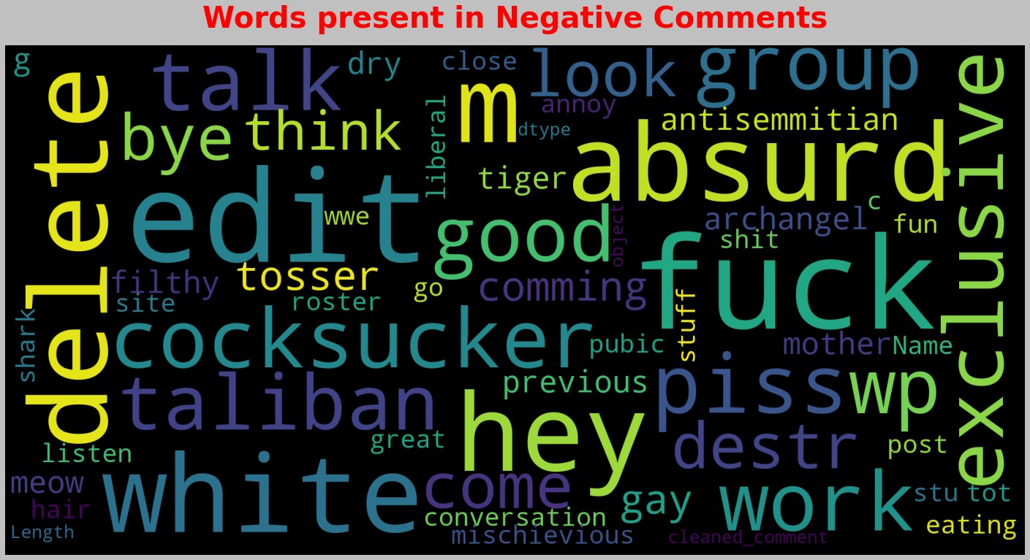
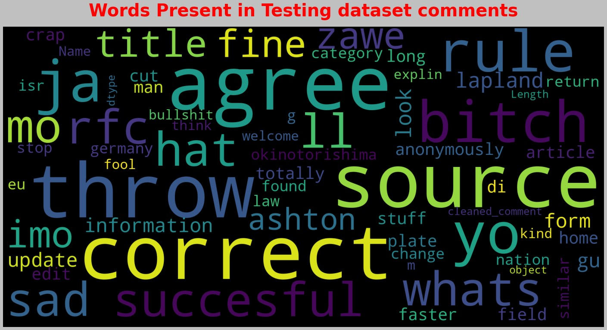

Slide 15
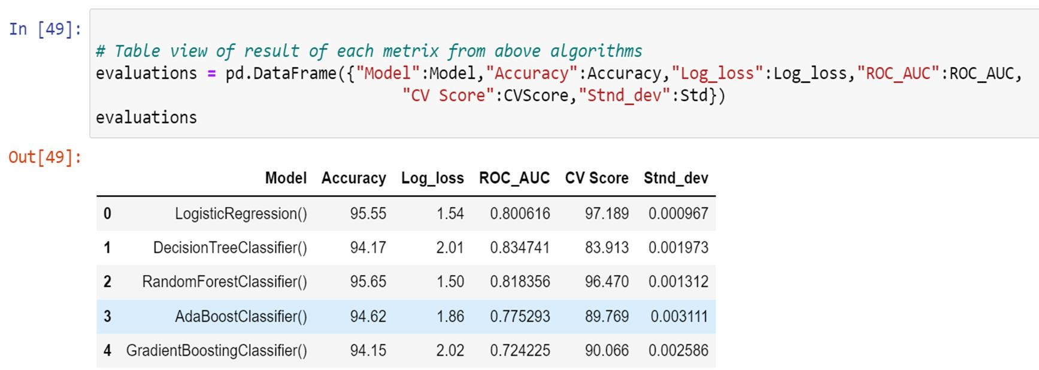
Interpretation Of The Results

Slide 16
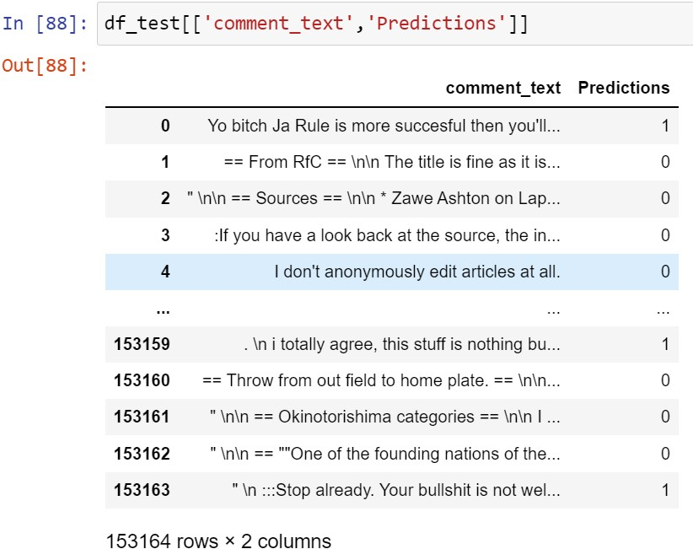
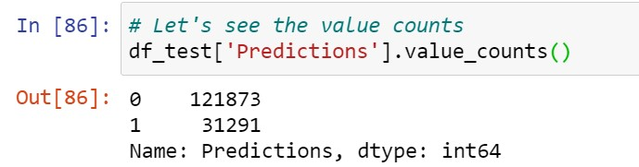
Prediction

Slide 17
Conclusion
Key Findings and Conclusions of the Study
The conclusion for our study: -
In training dataset, we have only 10% of data which is spreading hate on social media.
In this 10% data most of the comments are malignant, rude or abuse.
After using the word cloud, we find that there are so many abusive words present in the negative comments. While in positive comments there is no use of such comments.
Some of the comments are very long while some are very short.

Slide 18
• Learning Outcomes of the Study in respect of Data Science
From this project we learned a lot. Gains new techniques and ways to deal with uncleaned data. Find a solution to deal with multiple target features. Tools used for visualizations gives a better understanding of dataset. We have used a lot of algorithms and find that in the classification problem where we have only two labels, Logistic Regression gives better results compared to others.
But due to our system we could not use algorithms which gives much better results in NLP project like GaussinaNB, MultinomailNM. We also used googlecolab and some pipelines techniques but none of them worked here and also it was too much time consuming.
• Limitations of this work and Scope for Future Work
This project was amazing to work on, it creates new ideas to think about but there were some limitations in this project like unbalanced dataset, multiple target features. To overcome these limitations, we have to use balanced dataset so that during the training of dataset our algorithm will not give biased result.

Slide 19
Thank you
Preeti Singh

